Slide 1

Introduction to Bayesian statistics
GMS-MT2019
Wellcome Centre for Human Genetics
Instructor: Dr Andre Python

Slide 2
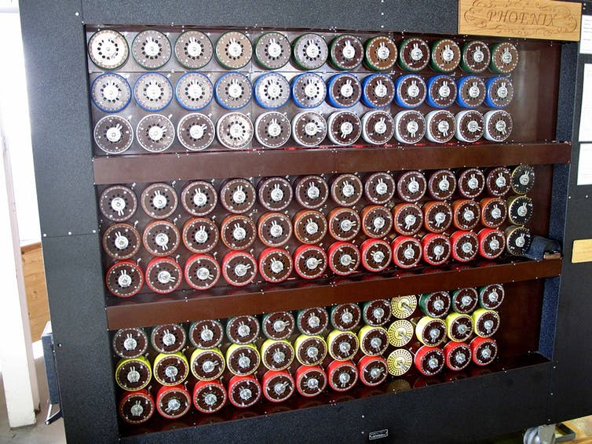
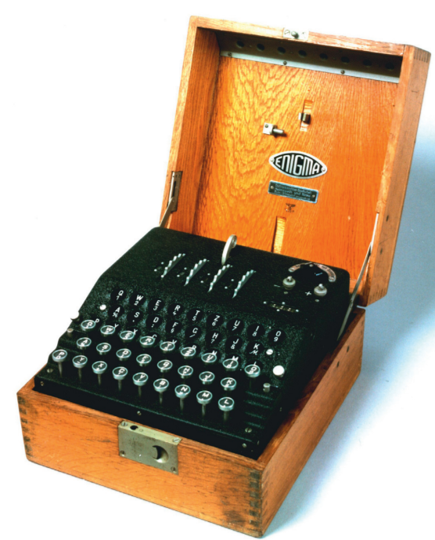
A rebuilt replica of a ‘bombe’ machine used by cryptologists to crack the German enigma code, Wikimedia.
Picture of Enigma, E. Simpson, June 2010, Significance 2010

Slide 3
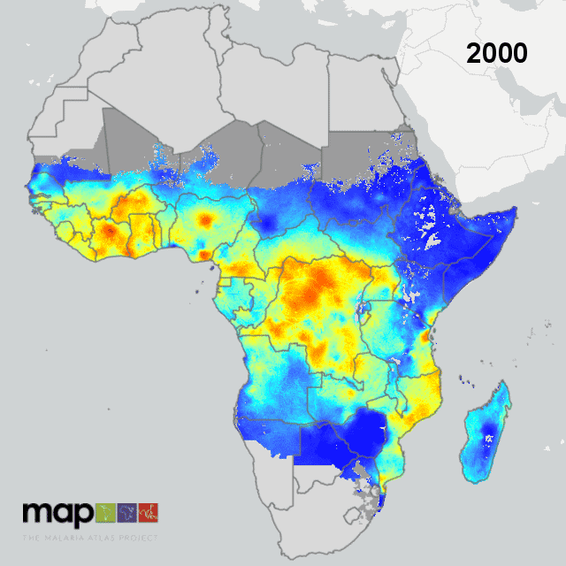
Bhatt S et al. The effect of malaria control on Plasmodium falciparum in Africa between 2000 and 2015. Nature. 2015;526(7572):207-211.
From MAP website to animated gif: Jennifer Rozier (MAP)

Slide 4
CHAI project: posterior mean (left) and standard deviation (right) of malaria in Guatemala

Slide 5
Bayesian inference is everywhere…
Science
Engineering
Philosophy
Medicine
Sport
Law
…

Slide 6
really everywhere…
Machine learning
Spam filters
Speech recognition
Bioinformatics
Economics
…

Slide 7
General schedule
Date: 4 and 5 November 2019 | Location: WCHG Room B
Detailed schedule
4 November
Theory Bayesian statistics: 9:30-12:00
Statistical Modelling: 13:00-16:30 (Dr Gavin Band)
5 November
Practical Bayesian statistics: : 9:30-12:00
Practical Bayesian statistics: 13:00-16:00
Summary/ further guidance/additional questions (optional): 16:00-16:30

Slide 8
Summary
THEORY
1. Preliminaries
1.1. Random variables
1.2. Probability function for a random variable
2. Introduction to Bayesian statistics
2.1. Comparison Bayesian vs frequentist statistics
2.2. Bayes’ Theorem
2.3. Prior distributions
2.4. Posterior summary
2.5. Bayes’ Theorem with multi-parameters
2.6. Model selection
2.7. Hypotheses testing

Slide 9
Main references
King R., Papathomas M., Thomas L. (2015). Course note MT4531. Bayesian Inference, University of St Andrews, School of Mathematics & Statistics.
Statistical Rethinking, A Bayesian Course with Examples in R and Stan, R. McElreath, CRC Press, 2016.

Slide 10
THEORY
Preliminaries
1.1. Random variables
A random (or stochastic) variable is a variable whose possible values are numerical outcomes of a random (or stochastic) phenomenon. We usually denote random variables with capital letters: X (discrete) ,Y (continuous).
Discrete random variable: takes only a countable number of distinct values
Ex: number of children in a family
Continuous (or nondiscrete) random variable: takes an infinite number of possible values
Ex: temperature

Slide 11
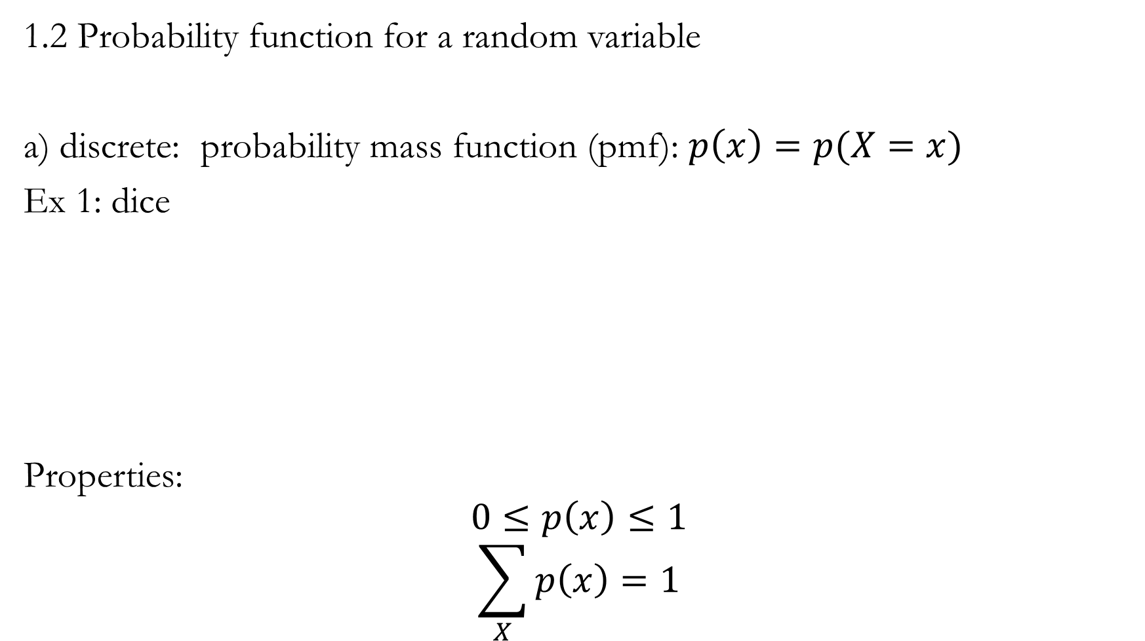
1.2 Probability function for a random variable
a) discrete: probability mass function (pmf): $p\left(x\right)=p(X=x)$
Ex 1: dice
Properties:
$$0≤p\left(x\right)≤1$$
$$\sum_{X}{p\left(x\right)=1}$$

Slide 12
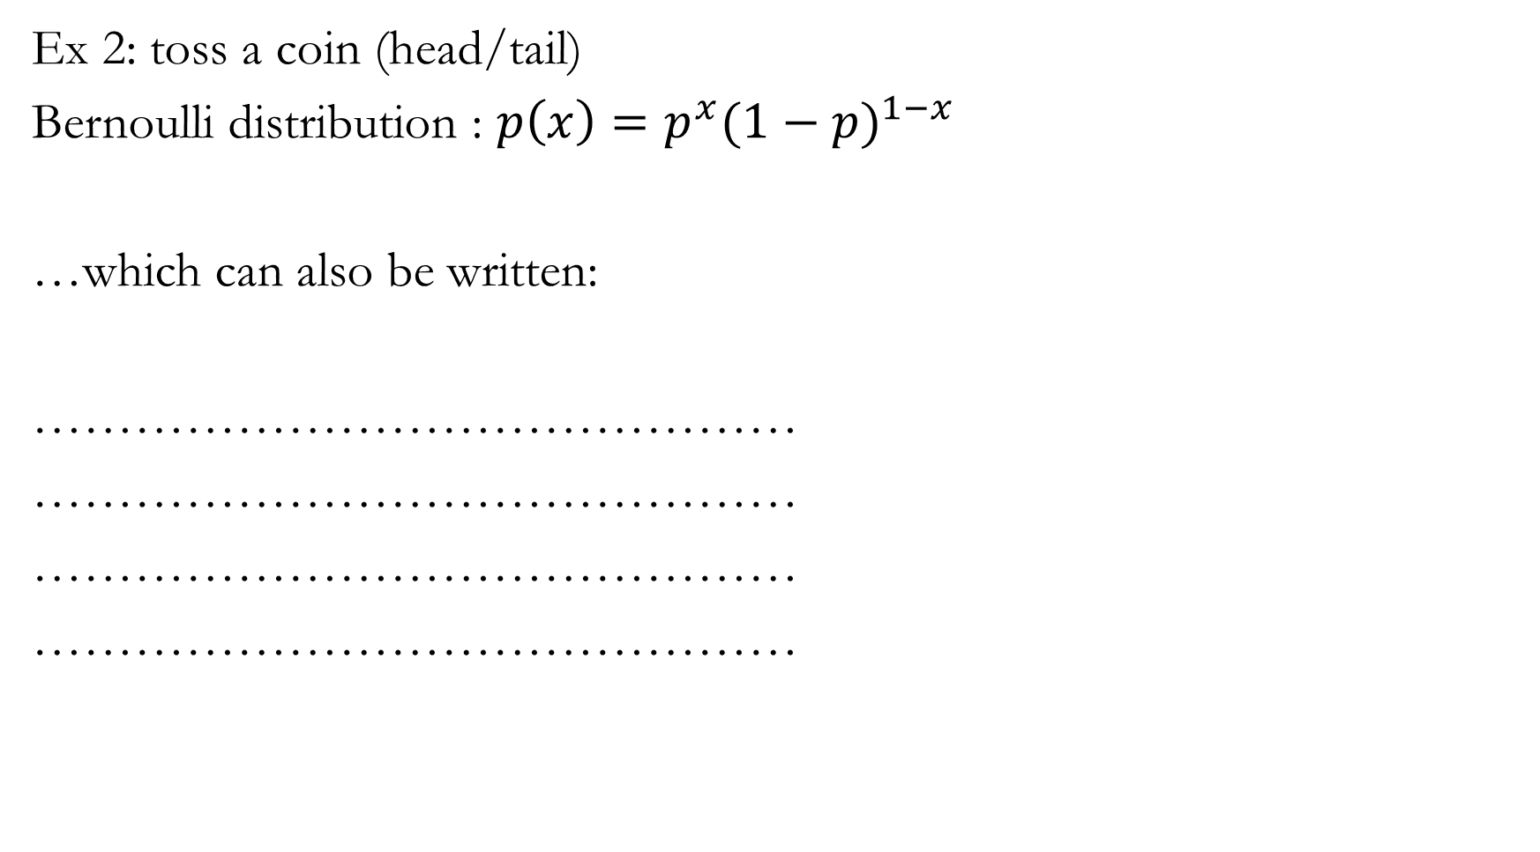
Ex 2: toss a coin (head/tail)
Bernoulli distribution : $p\left(x\right)=p^{x}{(1−p)}^{1−x}$
…which can also be written:
………………………………………
………………………………………
………………………………………
………………………………………

Slide 13
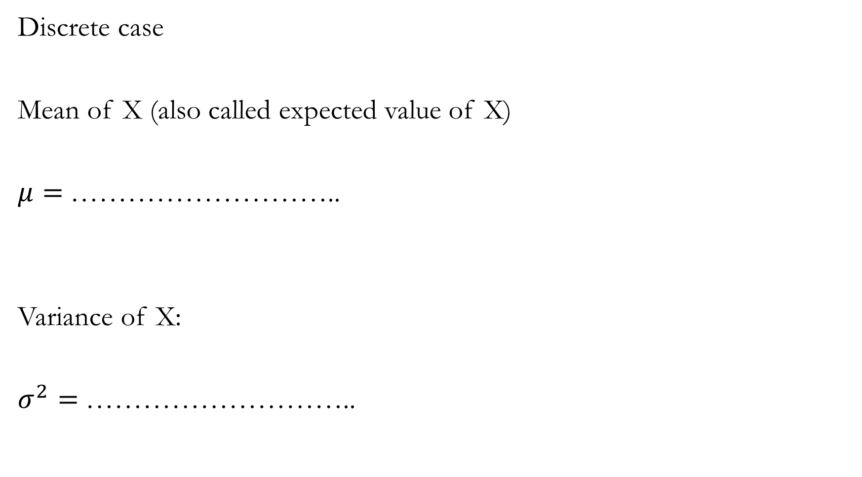
Discrete case
Mean of X (also called expected value of X)
$μ=$………………………..
Variance of X:
$σ^{2}=$………………………..

Slide 14
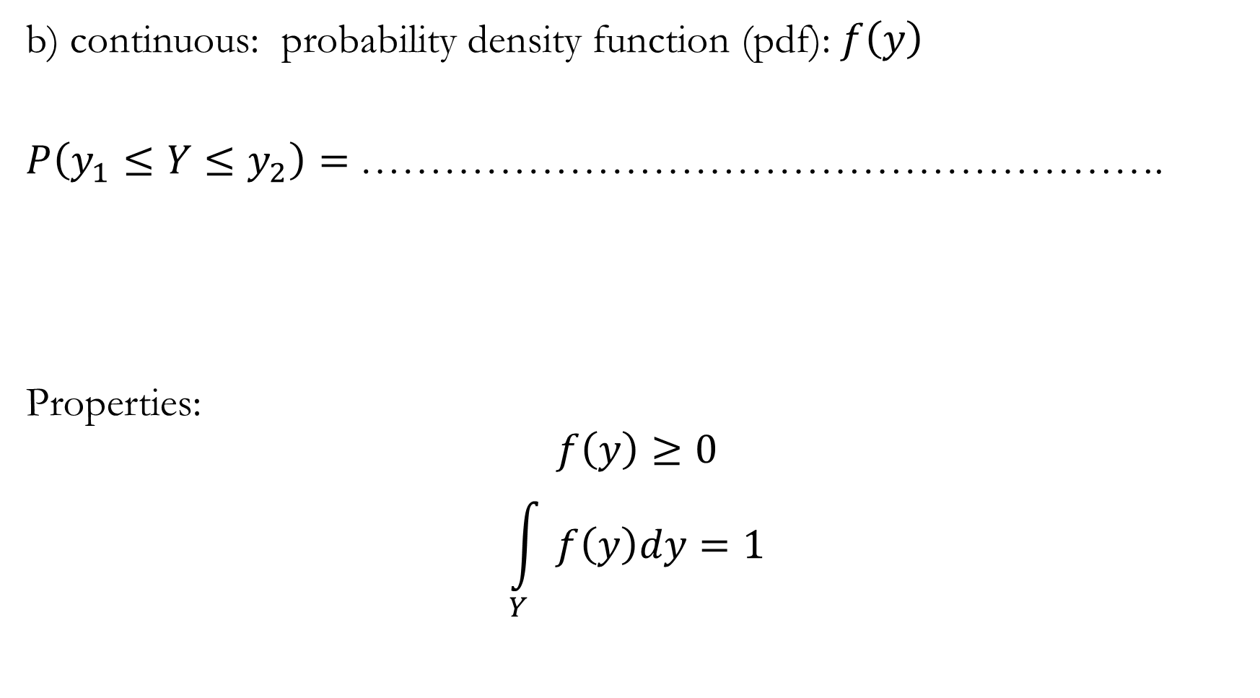
b) continuous: probability density function (pdf): $f\left(y\right)$
$P\left(y_{1}≤Y≤y_{2}\right)=$ ………………………………………………….
Properties:
$$f\left(y\right)≥0$$
$$\int_{Y}{f\left(y\right)dy=1}$$

Slide 15
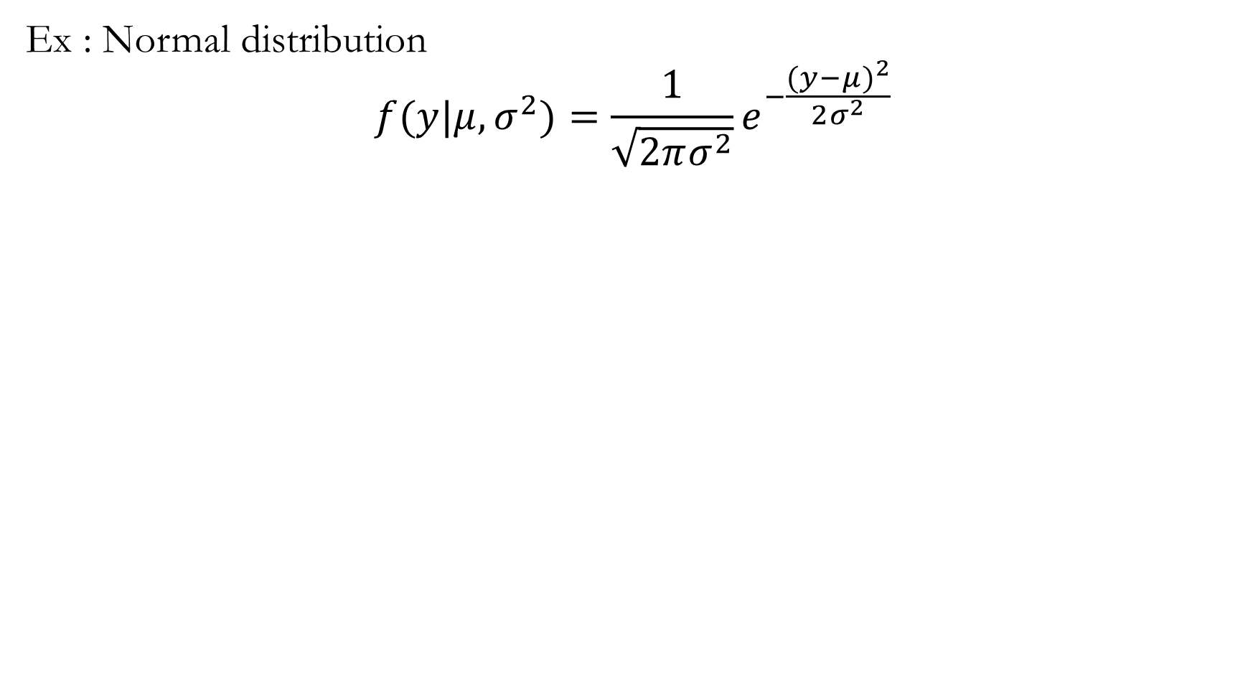
Ex : Normal distribution
$$f(y|μ,σ^{2})={\frac{1}{\sqrt{2πσ^{2}}}e}^{−\frac{({y−μ)}^{2}}{2σ^{2}}}$$

Slide 16
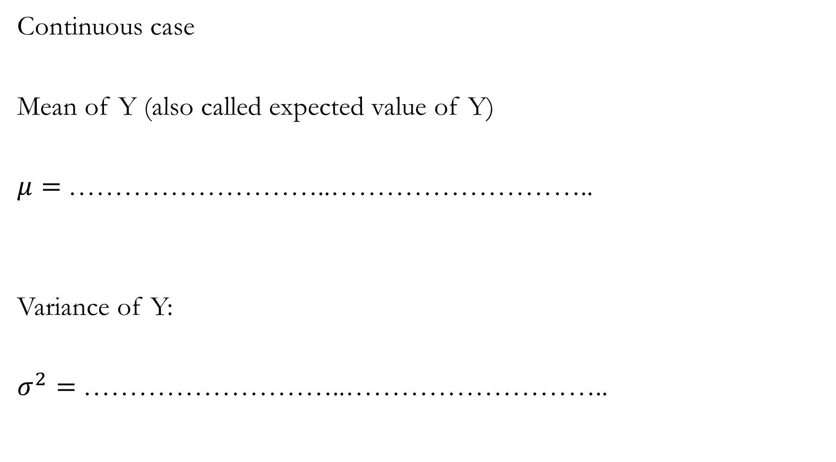
Continuous case
Mean of Y (also called expected value of Y)
$μ=$………………………..………………………..
Variance of Y:
$σ^{2}=$………………………..………………………..

Slide 17
2. Introduction to Bayesian statistics
Statistical inference: process of analysing data to deduce properties of an underlying probability distribution. It is assumed that the dataset is sampled form a larger population.
2.1. Comparison Bayesian vs frequentist approaches
Bayesian statistics is an alternative complete theory of statistics different from the frequentist, also-called classical statistics.
Any statistical problem can be tackled by either theory.
Probability theory: measure uncertainty in a coherent manner (e.g. probabilities should not contradict each other)
Classical statistics: inference when looking at data, usually after considering a mathematical model. It uses probability theory and various procedures (confidence intervals, p-value, etc.)
Bayesian statistics: inference when looking at data after considering a mathematical model. Based solely on probability theory

Slide 18
Comparison table
Frequentist | Object | Bayesian
………………….. | Prior information | …………………..
………………….. | Data | …………………..
………………….. | LSE, MLE, p-value | …………………..
………………….. | Model parameter θ | …………………..
………………….. | Inference | …………………..

Slide 19
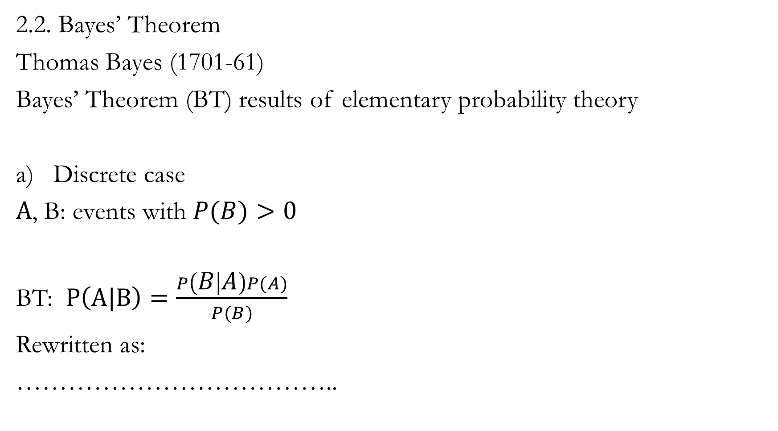
2.2. Bayes’ Theorem
Thomas Bayes (1701-61)
Bayes’ Theorem (BT) results of elementary probability theory
Discrete case
$A$, B: events with $P(B)>0$
BT: $P\left(A|B\right)=\frac{P\left(B | A\right)P(A)}{P(B)}$
Rewritten as:
………………………………..
A
B

Slide 20
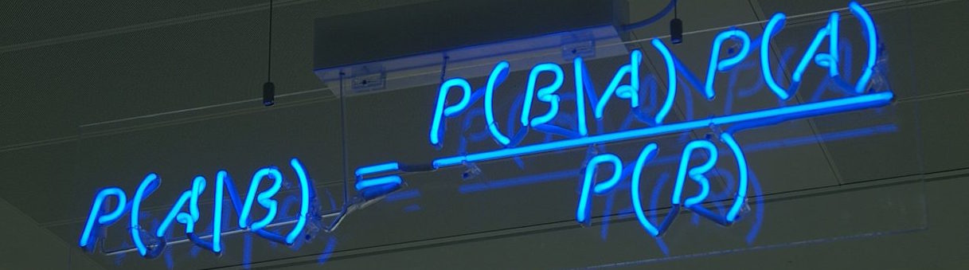

Slide 21
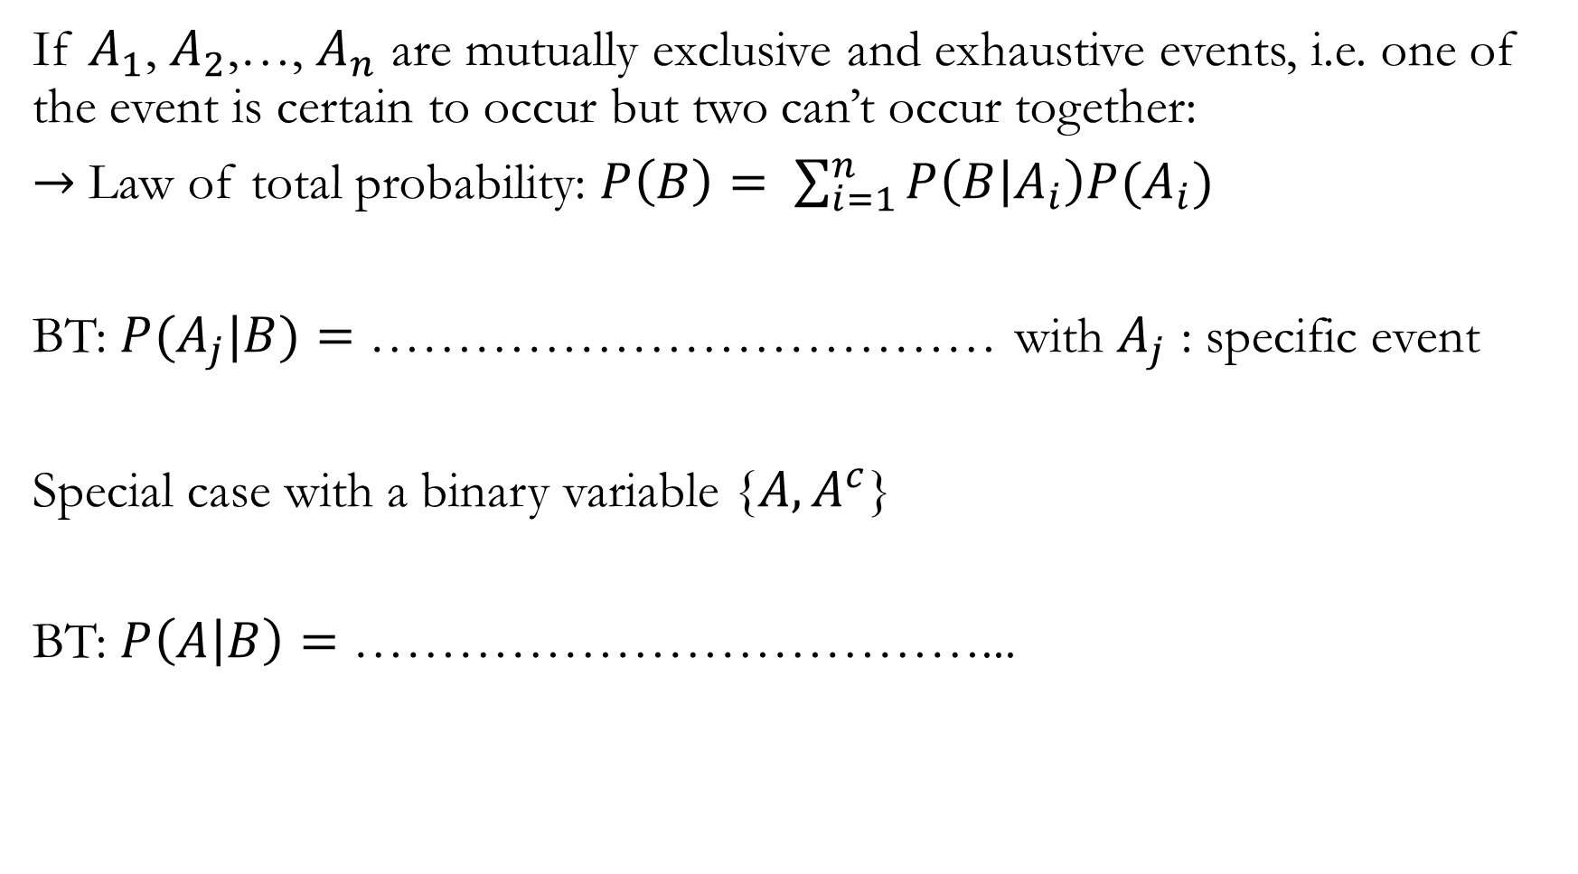
If $A_{1}$, $A_{2}$,…, $A_{n}$ are mutually exclusive and exhaustive events, i.e. one of the event is certain to occur but two can’t occur together:
$→$Law of total probability: $P\left(B\right)= \sum_{i=1}^{n}{P\left(B | A_{i}\right)P(A_{i})}$
BT: $P(A_{j}|B)=$ ……………………………… with $A_{j}$ : specific event
Special case with a binary variable {${A,A}^{c}$}
BT: $P\left(A | B\right)=$ ………………………………...

Slide 22
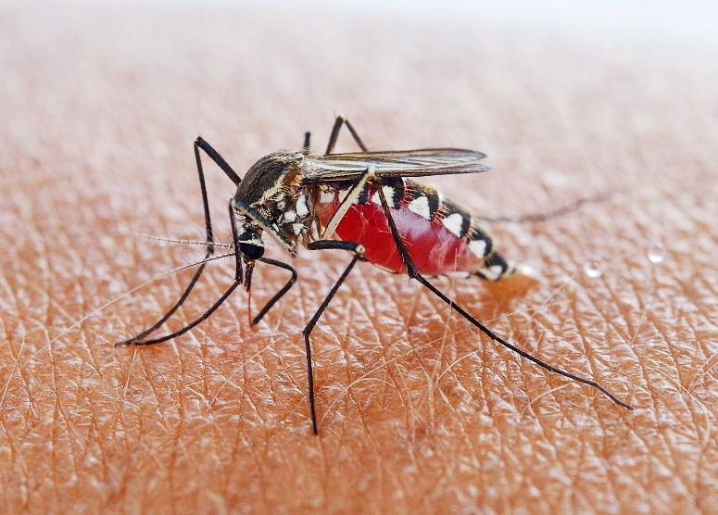
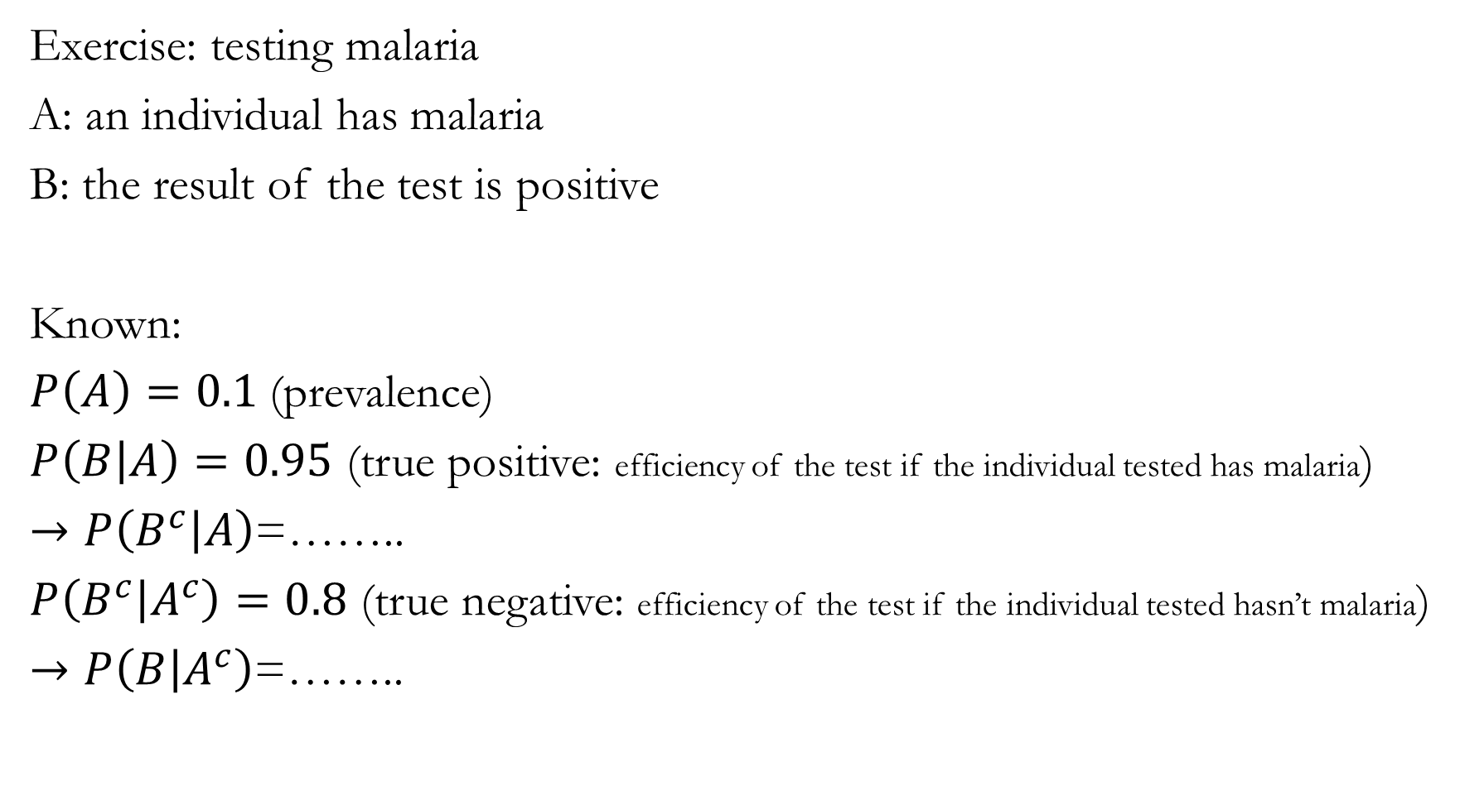
Exercise: testing malaria
A: an individual has malaria
B: the result of the test is positive
Known:
$P\left(A\right)=0.1$(prevalence)
$P\left(B | A\right)=0.95$ (true positive: efficiency of the test if the individual tested has malaria)
$→P\left(B^{c} | A\right)$=……..
$P\left(B^{c} | A^{c}\right)=0.8$ (true negative: efficiency of the test if the individual tested hasn’t malaria)
$→P\left(B | A^{c}\right)$=……..

Slide 23
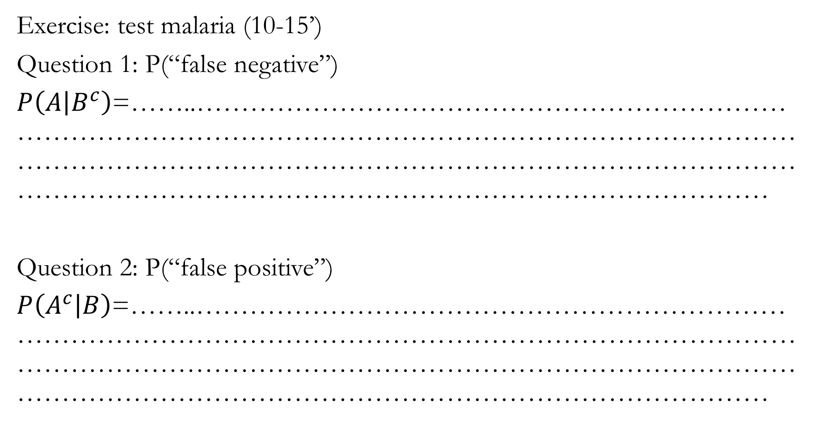
Exercise: test malaria (10-15’)
Question 1: P(“false negative”)
$P\left(A | B^{c}\right)$=……..………………………………………………………………………………………………………………………………………………………………………………………………………………………………………………………………………………………………
Question 2: P(“false positive”)
$P\left(A^{c} | B\right)$=……..………………………………………………………………………………………………………………………………………………………………………………………………………………………………………………………………………………………………

Slide 24
Break 10 minutes

Slide 25
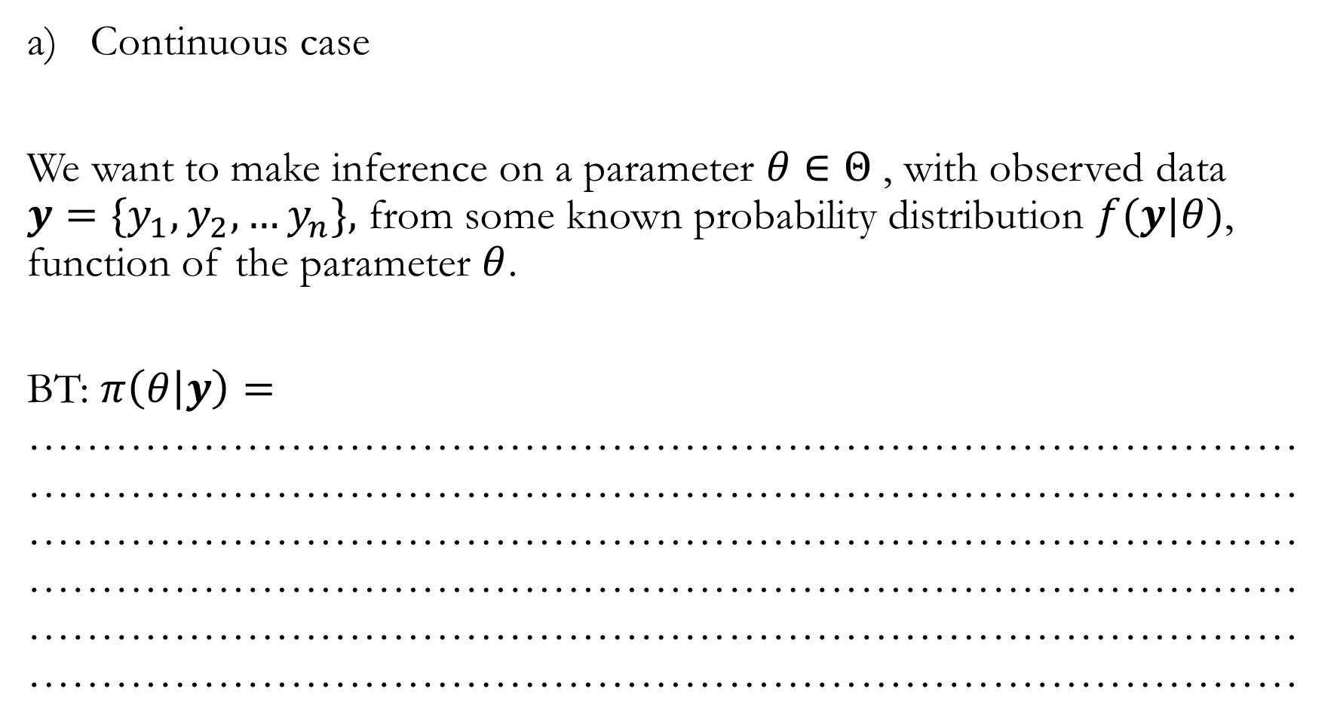
Continuous case
We want to make inference on a parameter $θ∈Θ$ , with observed data $y=\{y_{1},y_{2},…y_{n}\},$ from some known probability distribution $f(y|θ)$, function of the parameter $θ$.
BT: $π\left(θ | y\right)=$ ………………………………………………………………………………………………………………………………………………………………………………………………………………………………………………………………………………………………………………………………………………………………………………………………………………………………………………………………………………

Slide 26
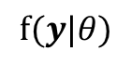
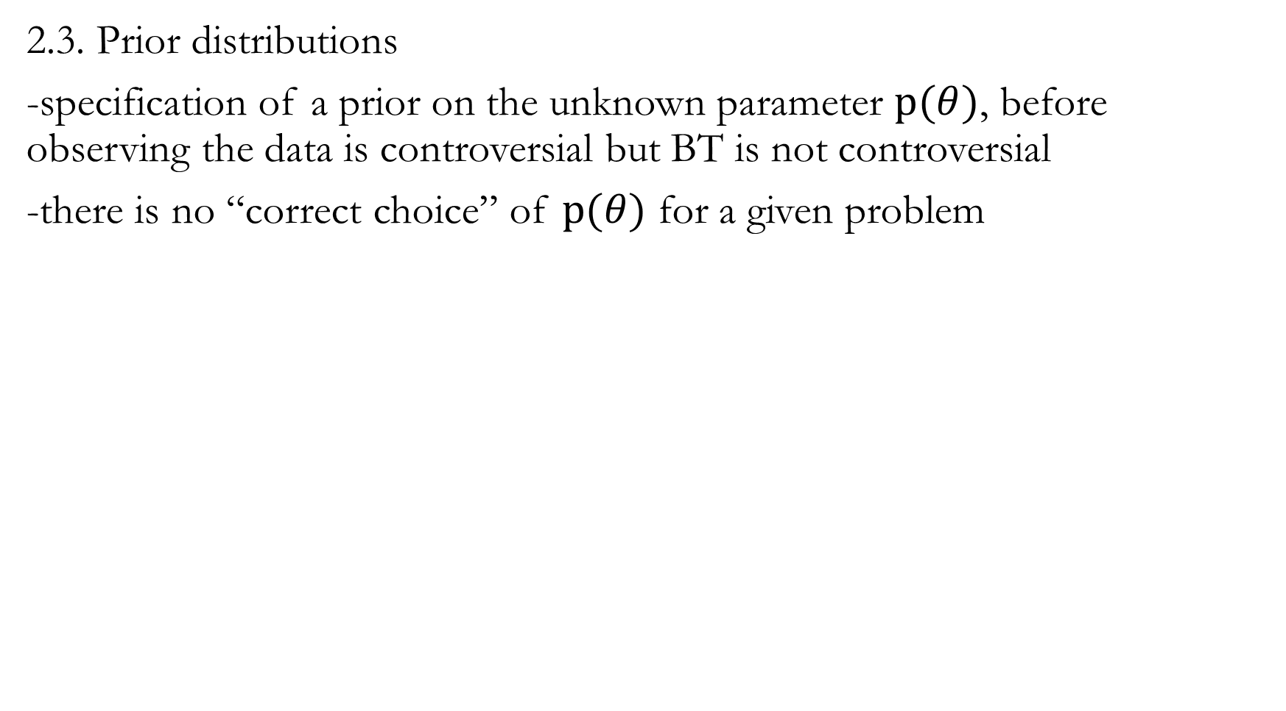
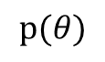
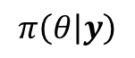
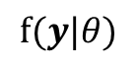
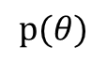
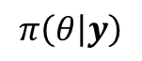
2.3. Prior distributions
-specification of a prior on the unknown parameter $p(θ)$, before observing the data is controversial but BT is not controversial
-there is no “correct choice” of $p(θ)$ for a given problem
Strong priors (“prior-driven” posteriors)
Weak priors (“data-driven” posteriors)
$$p(θ)$$
priors
$$p(θ)$$
priors
$$f(y|θ)$$
likelihood
$$f(y|θ)$$
likelihood
posteriors
posteriors
$$π\left(θ | y\right)$$
$$π\left(θ | y\right)$$

Slide 27
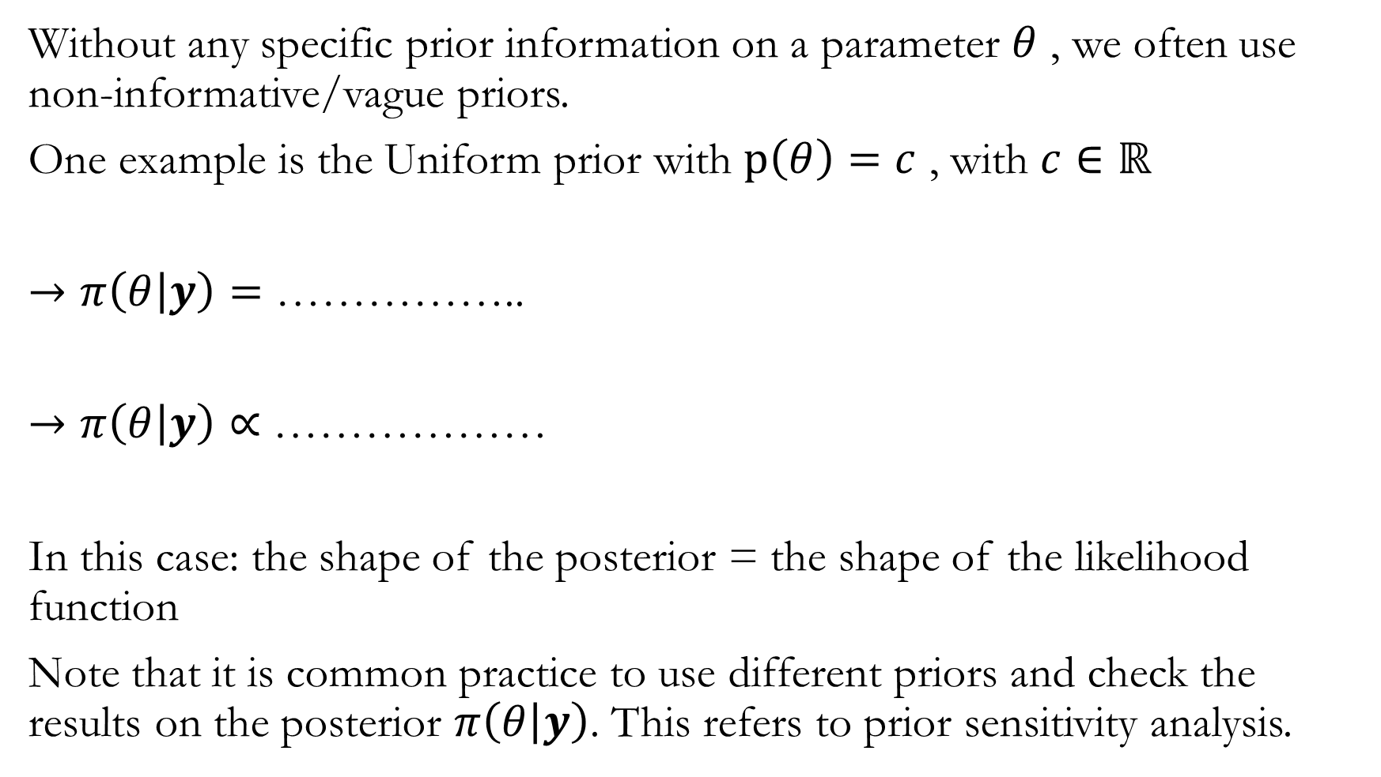
Without any specific prior information on a parameter $θ$ , we often use non-informative/vague priors.
One example is the Uniform prior with $p\left(θ\right)=c$ , with $c∈ℝ$
$→π\left(θ | y\right)=$ ……………..
$→π\left(θ | y\right)∝$ ………………
In this case: the shape of the posterior = the shape of the likelihood function
Note that it is common practice to use different priors and check the results on the posterior $π\left(θ | y\right)$. This refers to prior sensitivity analysis.

Slide 28
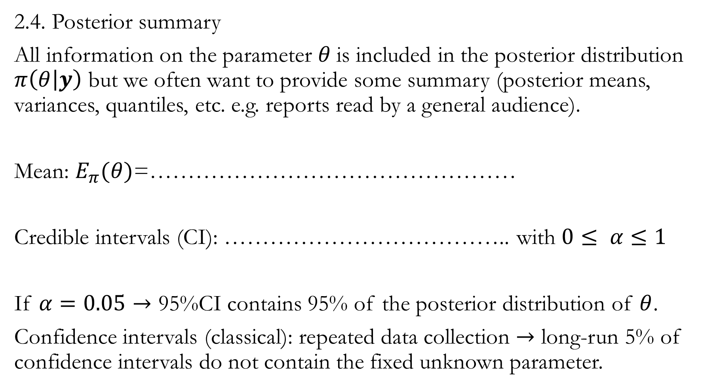
2.4. Posterior summary
All information on the parameter $θ$is included in the posterior distribution $π\left(θ | y\right)$ but we often want to provide some summary (posterior means, variances, quantiles, etc. e.g. reports read by a general audience).
Mean: $E_{π}(θ)$=…………………………………………
Credible intervals (CI): ……………………………….. with $0≤ α≤1$
If $α=0.05→$ 95%CI contains 95% of the posterior distribution of $θ$.
Confidence intervals (classical): repeated data collection $→$ long-run 5% of confidence intervals do not contain the fixed unknown parameter.

Slide 29
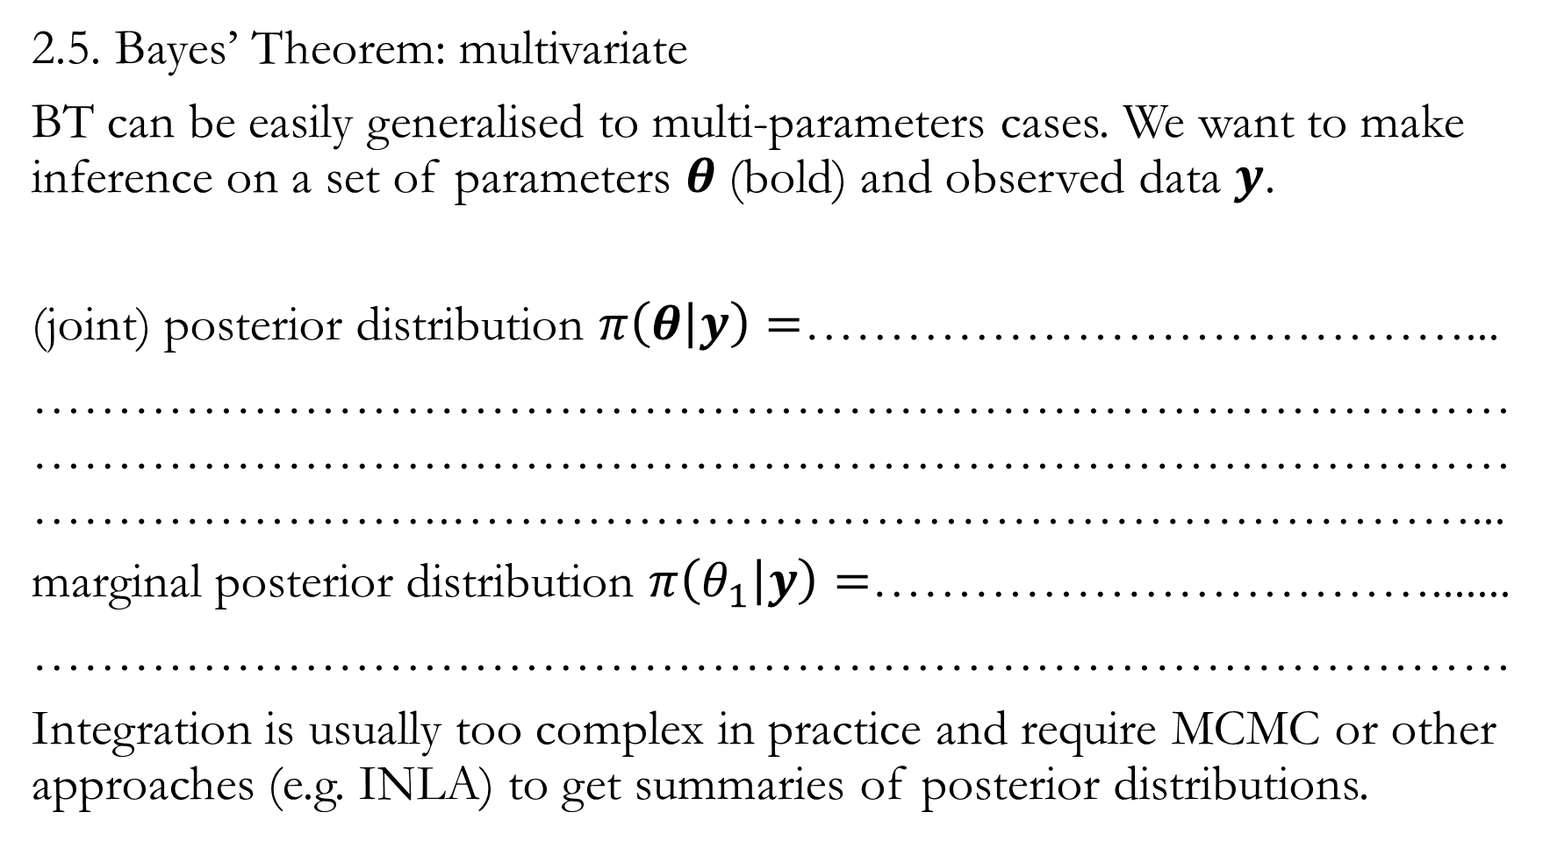
2.5. Bayes’ Theorem: multivariate
BT can be easily generalised to multi-parameters cases. We want to make inference on a set of parameters $θ$(bold) and observed data $y$.
(joint) posterior distribution $π\left(θ | y\right)=$…………………………………...
……………………………………………………………………………………………………………………………………………………………………………….……………………………………………………...
marginal posterior distribution $π\left(θ_{1} | y\right)=$…………………………….......
……………………………………………………………………………
Integration is usually too complex in practice and require MCMC or other approaches (e.g. INLA) to get summaries of posterior distributions.

Slide 30
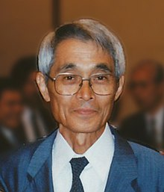
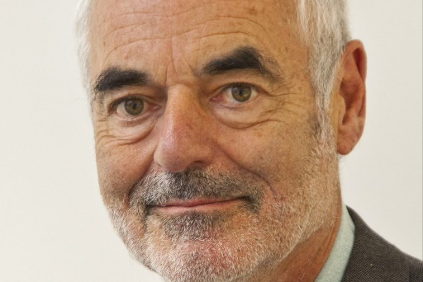
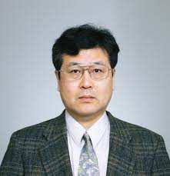
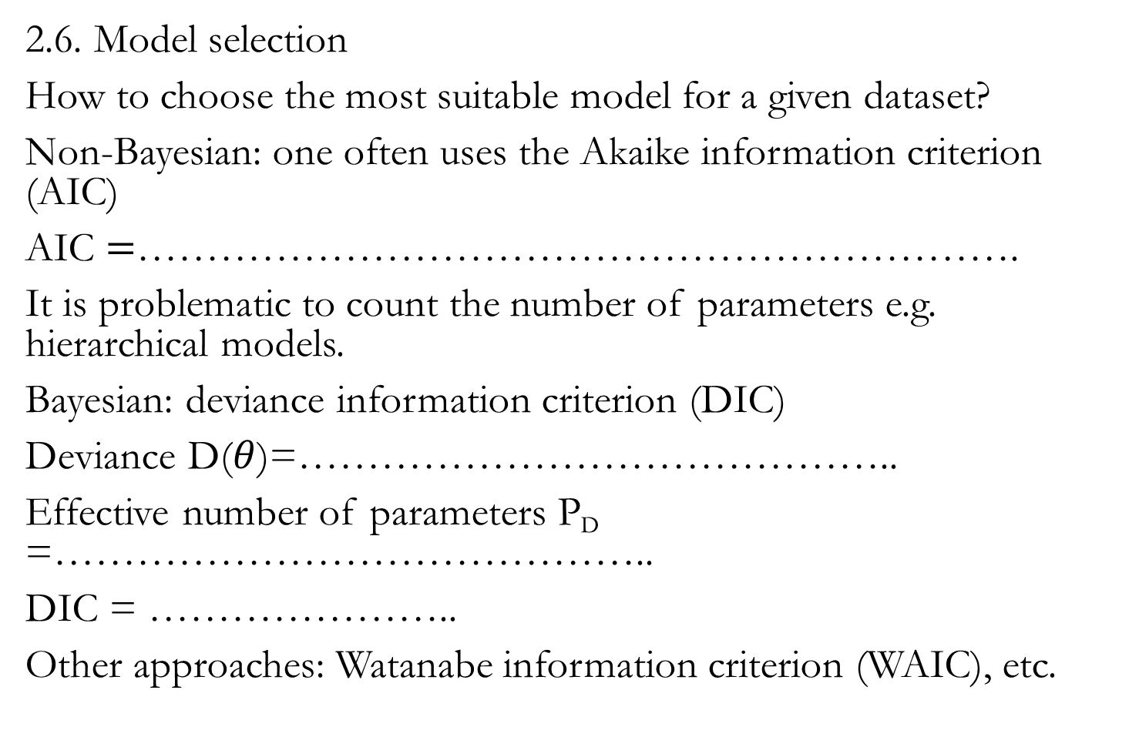
2.6. Model selection
How to choose the most suitable model for a given dataset?
Non-Bayesian: one often uses the Akaike information criterion (AIC)
AIC $=$……………………………………………………….
It is problematic to count the number of parameters e.g. hierarchical models.
Bayesian: deviance information criterion (DIC)
Deviance D($θ$)=……………………………………..
Effective number of parameters P_{D} =……………………………………..
DIC = …………………..
Other approaches: Watanabe information criterion (WAIC), etc.

Slide 31
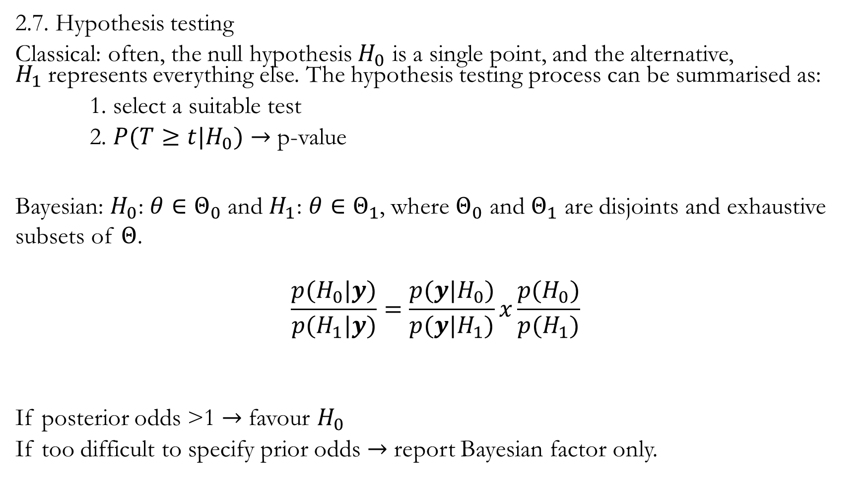
2.7. Hypothesis testing
Classical: often, the null hypothesis $H_{0}$ is a single point, and the alternative, $H_{1}$represents everything else. The hypothesis testing process can be summarised as:
1. select a suitable test
2. ${P(T≥t|H}_{0})→$ p-value
Bayesian: $H_{0}$: $θ∈Θ_{0}$ and $H_{1}$: $θ∈Θ_{1}$, where $Θ_{0}$ and $Θ_{1}$ are disjoints and exhaustive subsets of $Θ$.
$$\frac{{p(H}_{0}|y)}{{p(H}_{1}|y)}=\frac{p(y|H_{0})}{p(y|H_{1})}x\frac{{p(H}_{0})}{{p(H}_{1})}$$
If posterior odds >1 $→$ favour $H_{0}$
If too difficult to specify prior odds $→$ report Bayesian factor only.

Slide 32
Rule of thumb to interpret the Bayesian factor (BF) (Kass & Raftery, 1995)
BF | Interpretation
<3 | ……………………………………….
>3 | ……………………………………….
>20 | ……………………………………….
>100 | ……………………………………….

Slide 33
Interlude
Frequentist versus Bayesian

Slide 34


Slide 35
Prior subjectivity (some thoughts)
Priors are no more inherently subjective than are likelihoods and the repeat sampling assumptions required for significance testing
Without strong argument for a particular prior try different ones
Prior is an assumption and should be interrogated like other assumptions → making changes on it and checking how sensitive the results are to this assumption

Slide 36
End of the theory

